Slide 1
Notes:
2016 edits were only to change Colonomos Pedalogial Model to Colonomos Integrated Model (IMI). However, when footer was changed to 2016, all pages reflowed, so there are a lot of adjustments made to layout, but not to content. -- Nancy Creighton, Purple Swirl Arts.

Slide 2
Module 5: Interpreting Theory & Practice for Deaf Interpreters
Unit Titles & Sequence
Models of Interpretation
Translation
Consecutive Interpreting
Simultaneous Interpreting

Slide 3
Unit 1: Models of Interpretation
Key Questions
How do the four models of interpretation help Deaf interpreters clarify the process of interpreting?
How can Deaf interpreters use these models to identify their strengths and areas needing improvement?
How do these models help Deaf interpreters identify and resolve underlying causes of breakdowns in interpretation?
How can Deaf interpreters use the models of interpretation to make effective interpreting decisions?

Slide 4
Unit 1: Models of Interpretation
Interpretation & Translation
What does interpretation mean, and what does it involve?
What does translation mean, and what does it involve?
What are the goals of translating and interpreting content?
Provide an overview of the translation process.

Slide 5
Unit 1: Models of Interpretation
Introduction & Overview in NCIEC Teaching Modules for the Classroom
What are the differences between intra-lingual and inter-lingual interpreting tasks that Deaf interpreters undertake?
Review and expand on examples of intra-lingual interpreting tasks.
Describe individual experiences with inter-lingual interpreting.
Are you fluent in a second or third signed language?

Slide 6
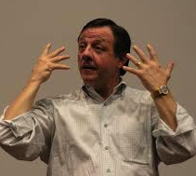
Unit 1: Models of Interpretation
Cokely Sociolinguistic Model
Message reception – Perceive source language
Preliminary processing – Recognize
Short-term memory retention – Chunk
Semantic intent realized – Understand
Semantic equivalent determined – Analyze
Syntactic message formulation – Rehearse
Message production – Produce target language

Slide 7
Unit 1: Models of Interpretation
Cokely Sociolinguistic Model, cont’d
View trainer-selected video
Assess the language of the Deaf or DeafBlind consumer (e.g., ASL dominant, semi-lingual) and determine the mode of interpreting to be used
Discuss challenges that the consumer’s language or communication needs might present within the context of the Cokely Model, including ideas for resolving these challenges

Slide 8
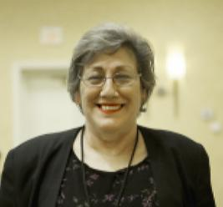
Unit 1: Models of Interpretation
Colonomos Integrated Model of Interpreting (IMI):
Focus on CRP (See Graphic) portion of IMI
Concentrating: Understanding source message – attending, analyzing, freeing the message from the form
Representing: Source frame/target switch
Preparing Delivery: Contextual protocols, coherence of content, affect, register, access resources: team member(s), supervisor (process management issues)

Slide 9
Unit 1: Models of Interpretation
Colonomos Integrated Model, (IMI) cont’d
View trainer-selected video
Assess the language of the Deaf or DeafBlind consumer (e.g., ASL dominant, semi-lingual) and determine the mode of interpreting to be used
Discuss challenges that the consumer’s language or communication needs might present within the context of the Integrated Model of Interpreting, including ideas for resolving these challenges

Slide 10
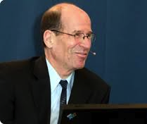
Unit 1: Models of Interpretation
Gile Comprehension & Effort Models
C (comprehension) = KL (knowledge of the language) + ELK (extra-linguistic knowledge) + A (interpreter’s analysis)
KL and ELK contribute to the effectiveness and quality of comprehension of content

Slide 11
Unit 1: Models of Interpretation
Gile Comprehension & Effort Models, cont’d
Not having KL and/or ELK increases comprehension effort
Preparation is critical to decrease the amount of comprehension effort, thus preserving mental energy required for interpreting

Slide 12
Unit 1: Models of Interpretation
Gile Comprehension & Effort Models, cont’d
View trainer-selected video and assess the language of the Deaf or DeafBlind consumer (e.g., ASL dominant, semi-lingual) and determine interpreting mode to be used
Discuss challenges that the consumer’s language or communication needs might present within the context of the Gile Models, including ideas for resolving these challenges

Slide 13
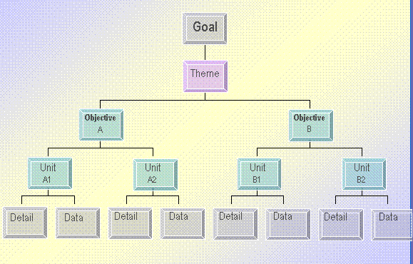
Unit 1: Models of Interpretation
Gish Information Processing Model
Mapping Elements:
Speaker goal
Theme
Objective/s
Unit/s
Data & details

Slide 14
Unit 1: Models of Interpretation
Gish Information Processing Model, cont’d
View trainer-selected video
Assess the language of the Deaf or DeafBlind consumer (e.g., ASL dominant, semi-lingual) and determine the mode of interpreting to be used
Discuss challenges that the consumer’s language or communication needs might present within the context of the Gish Model, including ideas for resolving these challenges

Slide 15
Unit 1: Models of Interpretation
Group Dialogue: Comparison
Cokely Model – message reception, preliminary processing, and semantic intent realization
Colonomos Model – concentrating, representing, and planning
Gile Model – information processing
Gish Models – comprehension and effort

Slide 16
Unit 1: Models of Interpretation
Group Dialogue: Comparison, cont’d
How do the four models help Deaf interpreters clarify the process of interpreting?
How can Deaf interpreters use the four models to identify their strengths and areas for improvement?
How do the four models help Deaf interpreters identify and resolve underlying causes for interpreting breakdowns?
How can Deaf interpreters use the four models to make effective interpreting decisions?

Slide 17
Unit 2: Translation
Key Questions
How does written translation differ from sight/text translation?
How does sight/text translation differ from consecutive and simultaneous interpreting?
What are possible situations that would call for Deaf interpreters to provide sight/text translation?
What kinds of knowledge and preparation are necessary for translation?

Slide 18
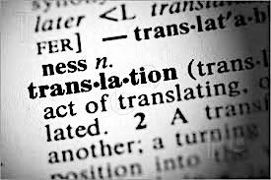
Unit 2: Translation
Review
Written/recorded translation
Back translation
Back translation check
Sight translation

Slide 19
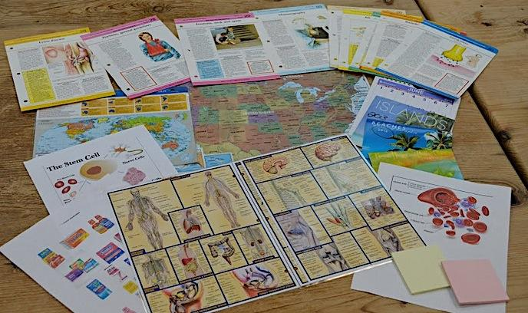
Unit 2: Translation
Sight Translation
Identify and discuss situations in which Deaf interpreters might be called upon to translate from written or print text into ASL or another form of visual communication

Slide 20
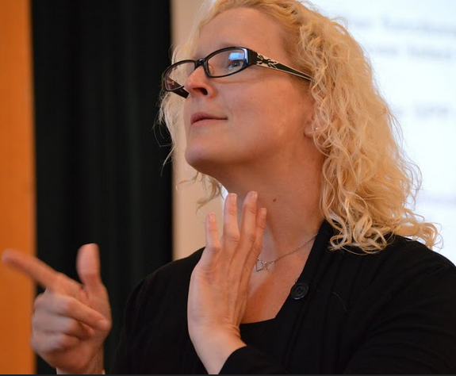
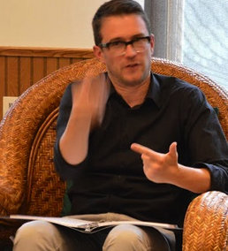
Unit 2: Translation
Sight Translation, cont’d
Frozen text
Procedural text
Explanatory text

Slide 21
Unit 2: Translation
Sight Translation, cont’d
Using the Gile Model, what ELK is required to translate:
Frozen text
Bank overdraft notice
Television captions
Medical consent form
Apartment lease

Slide 22
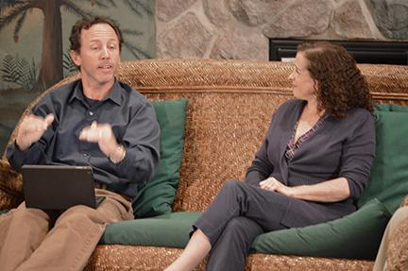
Unit 2: Translation
Sight Translation Steps
Prediction
Content mapping
Feature analysis
Visual representation
Prediction of target language features
Re-tell in target language
Comparative / contrastive analysis
Translation

Slide 23
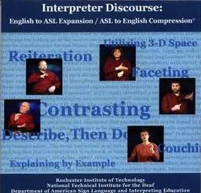
Unit 2: Translation
Interpreter Discourse Review
English to ASL Expansion
ASL to English Compression

Slide 24
Unit 2: Translation
Group Dialogue
View Pursuit of ASL: Interesting Facts Using Classifiers
Identify application of ASL expansion

Slide 25
Unit 2: Translation
English to ASL Sight/Text Translation Activity
Preparation: patient intake form or other print document
Divide into groups of three
Sight translator
Deaf or DeafBlind consumer
Observer

Slide 26
Unit 2: Translation
English to ASL Sight/Text Translation Activity, cont’d
Discuss observed examples of the following:
Elicitation strategies
Production strategies
Contextual information strategies
Application to Deaf interpreter practice

Slide 27
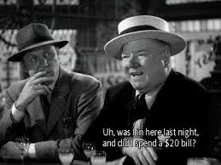
Unit 2: Translation
Simultaneous Translation Activity
Trainer-selected captioned movie, television show, or video
Predictions
Possible topics that may arise
Speakers’ goals
Salient linguistic features
Content
Translation Practice

Slide 28
Unit 2: Translation
Simultaneous Translation Activity, cont’d
English intrusion in translation efforts
Application to Deaf interpreter practice

Slide 29
Unit 2: Translation
NCIEC Teaching Modules for the Classroom: To Your Future Health–Contemplating Interpreting in Healthcare
Appropriate times for Deaf Interpreters to:
Sight/text translate independently
Hold off until healthcare providers are present
Take on the interpreting role

Slide 30
Unit 3: Consecutive Interpreting
Key Questions
What factors go into Deaf interpreters’ decision to interpret consecutively?
How can Deaf interpreters explain the rationale for using consecutive interpreting?
How do Deaf interpreters employ consecutive interpreting to their greatest advantage?

Slide 31
Unit 3: Consecutive Interpreting
Concept Review
History
Benefits
Skills
Techniques

Slide 32
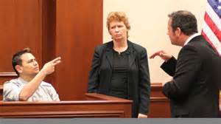
Unit 3: Consecutive Interpreting
Concept Review, cont’d
Examples of a Deaf Interpreter’s Work
Deaf Interpreting: Team Strategies for Interpreting in a Mental Health Setting
Deaf Interpreters at Work: Mock Trial

Slide 33
Unit 3: Consecutive Interpreting
Concept Review: Procedural Steps
Listening
Chunking
Short term memory
Note-taking
Analysis of meaning
Co-construction of meaning
Application of interpreting model/s
Delivery

Slide 34
Unit 3: Consecutive Interpreting
Discourse Analysis Process
Prediction
View & Recall
Content Mapping
Salient Linguistic Features
Abstraction
Retell in Source Language
Salient Linguistic Features
Visualization Mapping
Retell in Target Language
Interpretation

Slide 35
Unit 3: Consecutive Interpreting
Case Study 1—Sixth Grade Health Class
Deaf student has Deaf parents. ASL is L1, English is L2. Exposed to SEE through mainstream school. Struggles with fingerspelling (mild cerebral palsy). Teacher’s goal is for students to understand how bruises are formed and be familiar with vocabulary. There will be a test on bruises next week, with multiple choice and fill-in questions. For the test, students must be able to answer questions on how bruises are formed, in full sentences.

Slide 36
Unit 3: Consecutive Interpreting
Case Study 2—Eighth Grade Biology Class
Deaf student in mainstream day program since first grade. Spanish and ASL are L1 and L2, English is L3. Has hearing parents, all speak Spanish and know basic ASL. Small group of Deaf friends who use ASL and some signed English. Teacher’s goal is to teach about blood and its systems. One unit is related to how bruises are formed. Students must write an essay about blood systems, bruises, and how the blood system prevents more bleeding from broken blood vessels.

Slide 37
Unit 3: Consecutive Interpreting
Case Study 3—Doctor’s Office
Patient from another country in late 30s. Fluent in their native signed language. Has lived in USA for two years and is picking up ASL from other immigrants as well as American Deaf community. Third visit with doctor to learn results of blood tests. Doctor’s goal is to explain how bruises are formed and why the patient may be breaking out in so many bruises, possibly due to blood disease. Doctor is very concerned.

Slide 38
Unit 3: Consecutive Interpreting
Case Study 4—Doctor’s Office
Young hearing child with Deaf or DeafBlind mother whose L1 is ASL (monolingual), who graduated from a Deaf school after attending day mainstream program for a few years. Third visit with doctor to learn results of blood tests. Doctor’s goal is to explain how bruises are formed and why the patient may be breaking out in so many bruises. Doctor is very concerned and suspects the child has leukemia, a blood disease. Mother is very emotional.

Slide 39
Unit 3: Consecutive Interpreting
Case Study Analysis Process
Draw pictures or symbols, no words
Use ASL discourse structure and features
Framing the interpretation
Register/s and discourse genre/s
Salient language features
Contextualization (expansion) techniques

Slide 40
Unit 3: Consecutive Interpreting
Case Study Analysis Process, cont’d
Interpret
Appropriate target language
Different from ASL version
Demonstrate interpretation
Deaf interpreter
Deaf or DeafBlind consumer
Hearing consumer

Slide 41
Unit 3: Consecutive Interpreting
Case Study Analysis Process, cont’d
Debriefing
Features assisted in effectiveness
Features were missing
Examples of linguistic and cultural mediation

Slide 42
Unit 3: Consecutive Interpreting
Case Study Analysis Process, cont’d
Decision making processes
Discourse analysis & mapping
Application of interpreting process models
Learning experiences
Areas for skill improvement and future application

Slide 43
Unit 3: Consecutive Interpreting
Group Dialogue
How do Deaf interpreters explain the rationale for using consecutive interpreting?
What factors go into the decision for Deaf interpreters to interpret consecutively?
How do Deaf interpreters use consecutive interpreting to their greatest advantage?

Slide 44
Unit 4: Simultaneous Interpreting
Key Questions
What factors and considerations go into Deaf interpreter’s decision to use simultaneous interpreting?
In what settings do Deaf interpreters typically practice simultaneous interpreting?
What is the difference between mirroring and simultaneous interpretation?
What is the rationale for using simultaneous, consecutive, or a blend of interpreting methods in some situations?

Slide 45
Unit 4: Simultaneous Interpreting
Review
Definition
History and Uses in The Effective Interpreting Series: Simultaneous Interpreting from English
Colonomos and Gile Interpreting Process Models
Application to Deaf interpreter practice

Slide 46
Unit 4: Simultaneous Interpreting
Deaf Interpreter Experiences
Where have you seen Deaf interpreters at work?
View trainer-selected videos
Why was simultaneous interpreting the method of choice?
When observing the “feed” interpreter, what did you notice about their language use (e.g., ASL, signed English) and signing behaviors?
Share observations on the performance of Deaf interpreters in simultaneous interpreter settings.

Slide 47
Unit 4: Simultaneous Interpreting
Deaf Interpreter Experiences, cont’d
Define and discuss mirror interpreting
Overlay Colonomos and Gile Models
Contrast mirror vs. simultaneous interpreting
Depth of processing
Form and meaning
Effort

Slide 48
Unit 4: Simultaneous Interpreting
Relationship of Simultaneous & Consecutive Interpreting
Russell’s research on accuracy of simultaneous vs. consecutive interpreting
What considerations go into decision making whether to use simultaneous or consecutive?
When would it be appropriate to flow between simultaneous and consecutive?

Slide 49
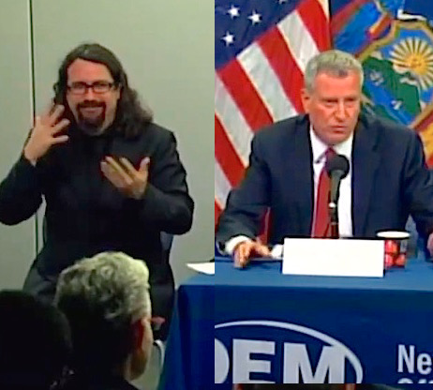
Unit 4: Simultaneous Interpreting
ASL Registers
Types
Frozen
Formal
Consultative
Informal/Casual
Intimate
Settings & Audiences

Slide 50
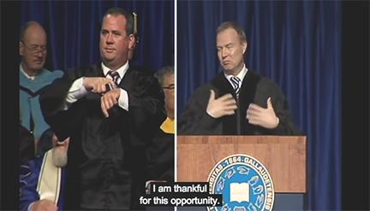
Unit 4: Simultaneous Interpreting
Examples of Simultaneous Approach
Gallaudet Commencement Speaker–WFD President
Gallaudet Deaf Way II Presentation Series–Video Conference Interpreting Project, International Sign
Helen Keller National Center Conference–DeafBlind Focus

Slide 51
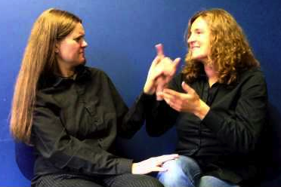
Unit 4: Simultaneous Interpreting
DeafBlind Considerations
Teaching Modules for the Classroom: DeafBlind Interpreting
Pro-Tactile: Understanding Touch Techniques to Facilitate Communication with DeafBlind People
Pro-Tactile: The DeafBlind Way

